Slide 1
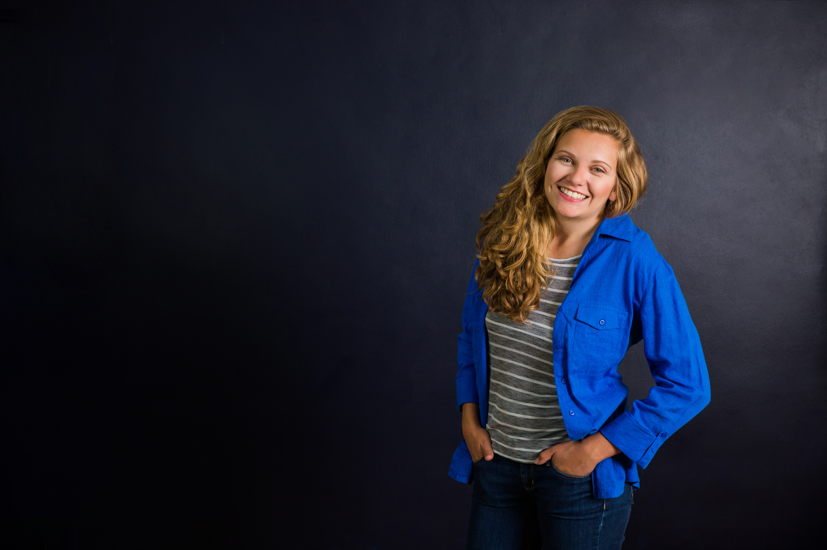
Sweet Briar College
BRAND GUIDE

Slide 2


A brand guide is a tool that helps all ambassadors — marketers, administrators, admissions counselors and community representatives (e.g., alumnae) alike — communicate about Sweet Briar College consistently and effectively. At its core, the brand guide defines the look and feel of Sweet Briar: our point of view, voice and visual DNA. It anchors our community to a shared perspective, which leads to a stronger brand that stays true to Sweet Briar.
What is a
BRAND GUIDE?
August 2017

Slide 3
This brand guide contains a number of useful components, including approved brand messaging, creative and visual direction, and fundamental design elements. Use this guide to stay on-brand for any kind of Sweet Briar communications — on any platform — from social media to admissions pieces, websites to billboards. The guide is meant to serve as a resource, not necessarily a strict rulebook, equipping communicators with flexible parameters that evolve with the brand.
Using this
BRAND GUIDE
August 2017

Slide 4

Starting the
CONVERSATION
August 2017

Slide 5
The brand positioning defines the space Sweet Briar College occupies that no one else can claim.
………………………………………………………………………….
In a world where the beaten path is too often the chosen one, Sweet Briar College is where women are encouraged to fearlessly forge their own. We challenge and support our students to become fulfilled women of consequence — self-directed and independent, they are strong leaders for their communities and world.
Brand
POSITIONING
August 2017

Slide 6
The brand pledge is our — all of Sweet Briar’s — promise to our students. It represents the sustaining beliefs and values that motivate us to do what we do.
………………………………………………………………………….
We’re fiercely committed to your individual growth — as a woman, as an intellectual and as a leader — and we’ll give you the space and sisterhood you need to thrive.
Brand pledge and
PROMISE
August 2017

Slide 7
The brand personality is the personification of our brand: who Sweet Briar would be — and what it would sound like — if it were a person.
……...………………………………………………………………….
The visionary coach with big expectations for her team, partnering with players to build the framework and confidence they need to set — and achieve — ambitious goals.
Brand
PERSONALITY
August 2017

Slide 8
Take charge
We know who we are — and we’re proud of where we’re going. Sweet Briar’s is a story of tradition, momentum and determination. No other institution can claim what we have, so let’s own it. Our students and alumnae are brave, bold and self-assured too, and many of them chalk it up to their time spent here.
Intelligent
Sweet Briar women are smart. They’re witty, curious and driven. Our professors understand that no two students are alike. They help create customized learning options to maximize each woman’s experience at Sweet Briar.
Inviting
For many, Sweet Briar becomes home. It’s not just our beautiful 3,250-acre campus; it’s the people. We all know one another, professors have students over for dinner and alumnae are quick to offer mentorship. That sense of familiarity and warmth should extend throughout our communications.
Our
VOICE
August 2017

Slide 9
Brand
MESSAGING
August 2017

Slide 10
Brand messages are just the beginning of the conversation.
………………………….……………………………………………….
They aren’t the entire conversation. These brand messages start to articulate the key pillars of Sweet Briar: what makes us special. They are written in the recommended editorial voice and supply phrases you can readily adopt for your own communications and conversations.
At the center of this set is the core message.
………………………………………………………………………….
It should serve as your foundation when communicating about Sweet Briar, be it in an elevator or an email. The four supporting messages address our unique differentiators, educational philosophy, beautiful campus, powerful network and transformative opportunities.
This is not a script. These messages should be treated as living, breathing language that you can adapt to fit your audience and mode of communication, while always remaining true to the core ideas and style.
Using
BRAND MESSAGES
August 2017

Slide 11
Confidence, courage and grit. Women of consequence. ………………………………………………………………………….
Independent-minded, fiercely determined to see your dreams through: deep down, you know that’s who you’ve always been. At Sweet Briar College, we’re here to reveal and amplify everything that makes you amazing, and help you own it in ways you never thought possible. You’ll be surrounded by a family of faculty, coaches and friends who will push you, excite you and energize you — to take what you learn into the world and take the lead. Our students have a favorite rallying cry, “There’s nothing that you cannot do.” You’ll discover that, here, it rings true every day.
Core
MESSAGE
August 2017

Slide 12
A powerful environment you’ll always call home. ………………………………………………………………………….
Sweet Briar is a beautiful place — but that beauty is not just skin-deep. Our campus, listed by the National Register of Historic Places and located in the foothills of the Blue Ridge Mountains, is intentionally intimate. It’s buzzing with ideas and designed to build a sense of community, to be a place where everyone counts. Good times, positivity and meaningful connections are always close by, and people genuinely look out for one another. All kinds of possibilities will unfold for you here, because our campus will give you the space you need to explore, research and achieve.
Supporting
MESSAGES
August 2017

Slide 13
Behind every Sweet Briar Woman is a team who
believes in her.
………………………………………………………………………….
Our faculty and student support staff are united in a common cause: to be the mentors you’ve always wanted, and to empower you to grow as a bold, independent thinker. And because no two Sweet Briar women are alike, they’ll work with you to plan a customized learning experience — one that reflects who you’re becoming and focuses your personal goals. Your advisors’ doors— and their professional contacts — will always be open to you. It’s the combination of challenge and guidance you’ll need to pursue that research project, tackle that complex material, go for that leadership position and take that life-changing internship.
Supporting
MESSAGES
August 2017

Slide 14
Amazing things will be expected of you.
And you’ll deliver.
………………………………………………………………………….
You’ll graduate from Sweet Briar career-ready and life-ready: you’ll know who you are and what you do best. In the professional world, that means you’ll always be in demand. Sweet Briar graduates fearlessly take initiative, solve problems collaboratively, achieve big goals and speak up for what’s right. You’ll also be in good company, joining the strong network of Sweet Briar alumnae — savvy leaders in their communities and in every sector. It’s a powerful, close-knit sisterhood, united by unwavering pride in their alma mater — and in their ability to get things done.
Supporting
MESSAGES
August 2017

Slide 15
Our roots are strong and run deep.
………………………………………………………………………….
Generations of amazing women have saved a special place in their hearts for Sweet Briar. Their steadfast love for their alma mater inspires us, holds us accountable, and keeps us strong. It’s why we take such pride and care in keeping our campus beautiful; why we are careful stewards of every resource; why the faculty come here and stay here. When you join the Sweet Briar family, you entrust us with helping you write the most important chapter of your life so far, and we are committed to seeing that chapter through, from start to finish.
Supporting
MESSAGES
August 2017

Slide 16
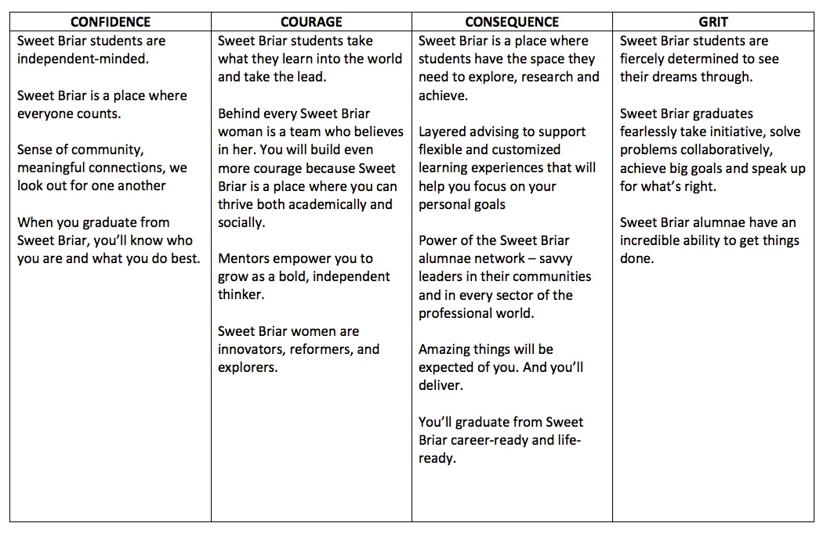

Slide 17
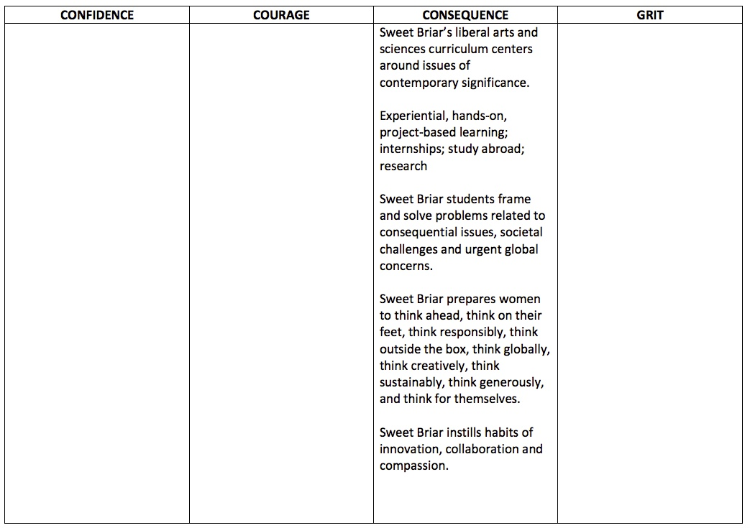

Slide 18


Slide 19
Expressing
THE BRAND
August 2017

Slide 20
Heads, subheads and quotes – Archer
Consider ITALIC and/or UPPER CASE for emphasis.
………………………………………………………………………….
Archer Bold
Archer Bold Italic
Archer Medium Italic
Body Copy – Avenir
Use for body copy, sentence case.
………………………………………………………………………….
Avenir book
Avenir book oblique
Avenir black
Avenir black oblique
Print
TYPOGRAPHY
August 2017

Slide 21
Heads, subheads and quotes – Arvo
Sentence case. Consider ITALIC and/or UPPER CASE for emphasis, but never use all-caps in web navigation.
……………………………………………………………………………
Arvo Bold
Arvo Bold Italic
Arvo Book
Arvo Book Italic
Body Copy – Nunito Sans
Use for body copy, sentence case.
……………………………………………………………………………
Nunito Sans Regular
Nunito Sans Italic
Web and mobile
TYPOGRAPHY
August 2017
Notes:
MELISSA – I DO NOT HAVE ARVO LOADED ON MY COMPUTER. THE FONTS HERE ARE ARCHER AND AVENIR

Slide 22
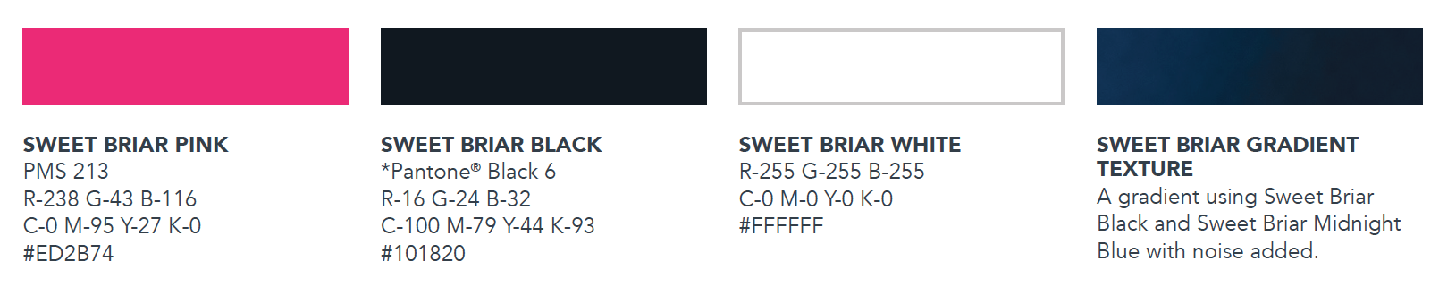
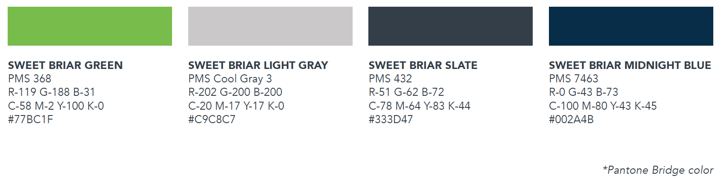


Color is integral to Sweet Briar’s brand. Consistent use of the color palette will reinforce the cohesiveness of the brand.
Brand
Primary
COLORS
Accent
Print
Web
August 2017

Slide 23


Our identity system has two styles: a stacked logo and a wordmark. These are restricted to official Sweet Briar College use. Personal publications are not permitted to display the stacked logo or logo wordmark. Student groups or alumnae may use the College’s stacked logo or the wordmark only if usage is approved before publishing. Any use of the stacked logo or the wordmark must follow the visual standards guide.
Sweet Briar Stacked Logo
………………………………………………………………..…………
Brand
IDENTITY
The stacked version is the preferred logo in all communications.
Sweet Briar Wordmark
…………………………………………………..…………
The wordmark should be used sparingly, only when the page size and orientation do not allow room for the stacked logo.
August 2017

Slide 24
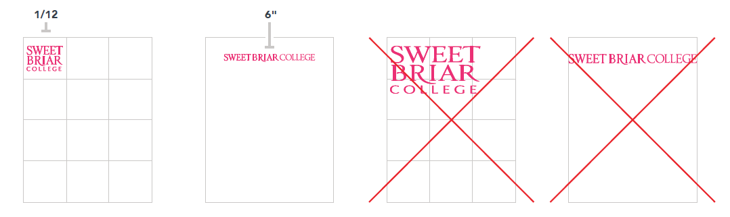

Logo size
………………………………………………………………………….
The stacked logo is intended as a visual identifier, not a title block, and should scale as such. In general publication usage, the stacked logo should be no larger than one-twelfth the size of the page on which it appears; the wordmark should not be more than six inches in length. Do not distort the logos by altering their aspect ratios.
Brand
IDENTITY
Protected area
……………………………….……………………………………..……
An area that surrounds the stacked logo, equivalent to one-tenth its height, should be free of all graphics, text, headlines or other information.
August 2017

Slide 25
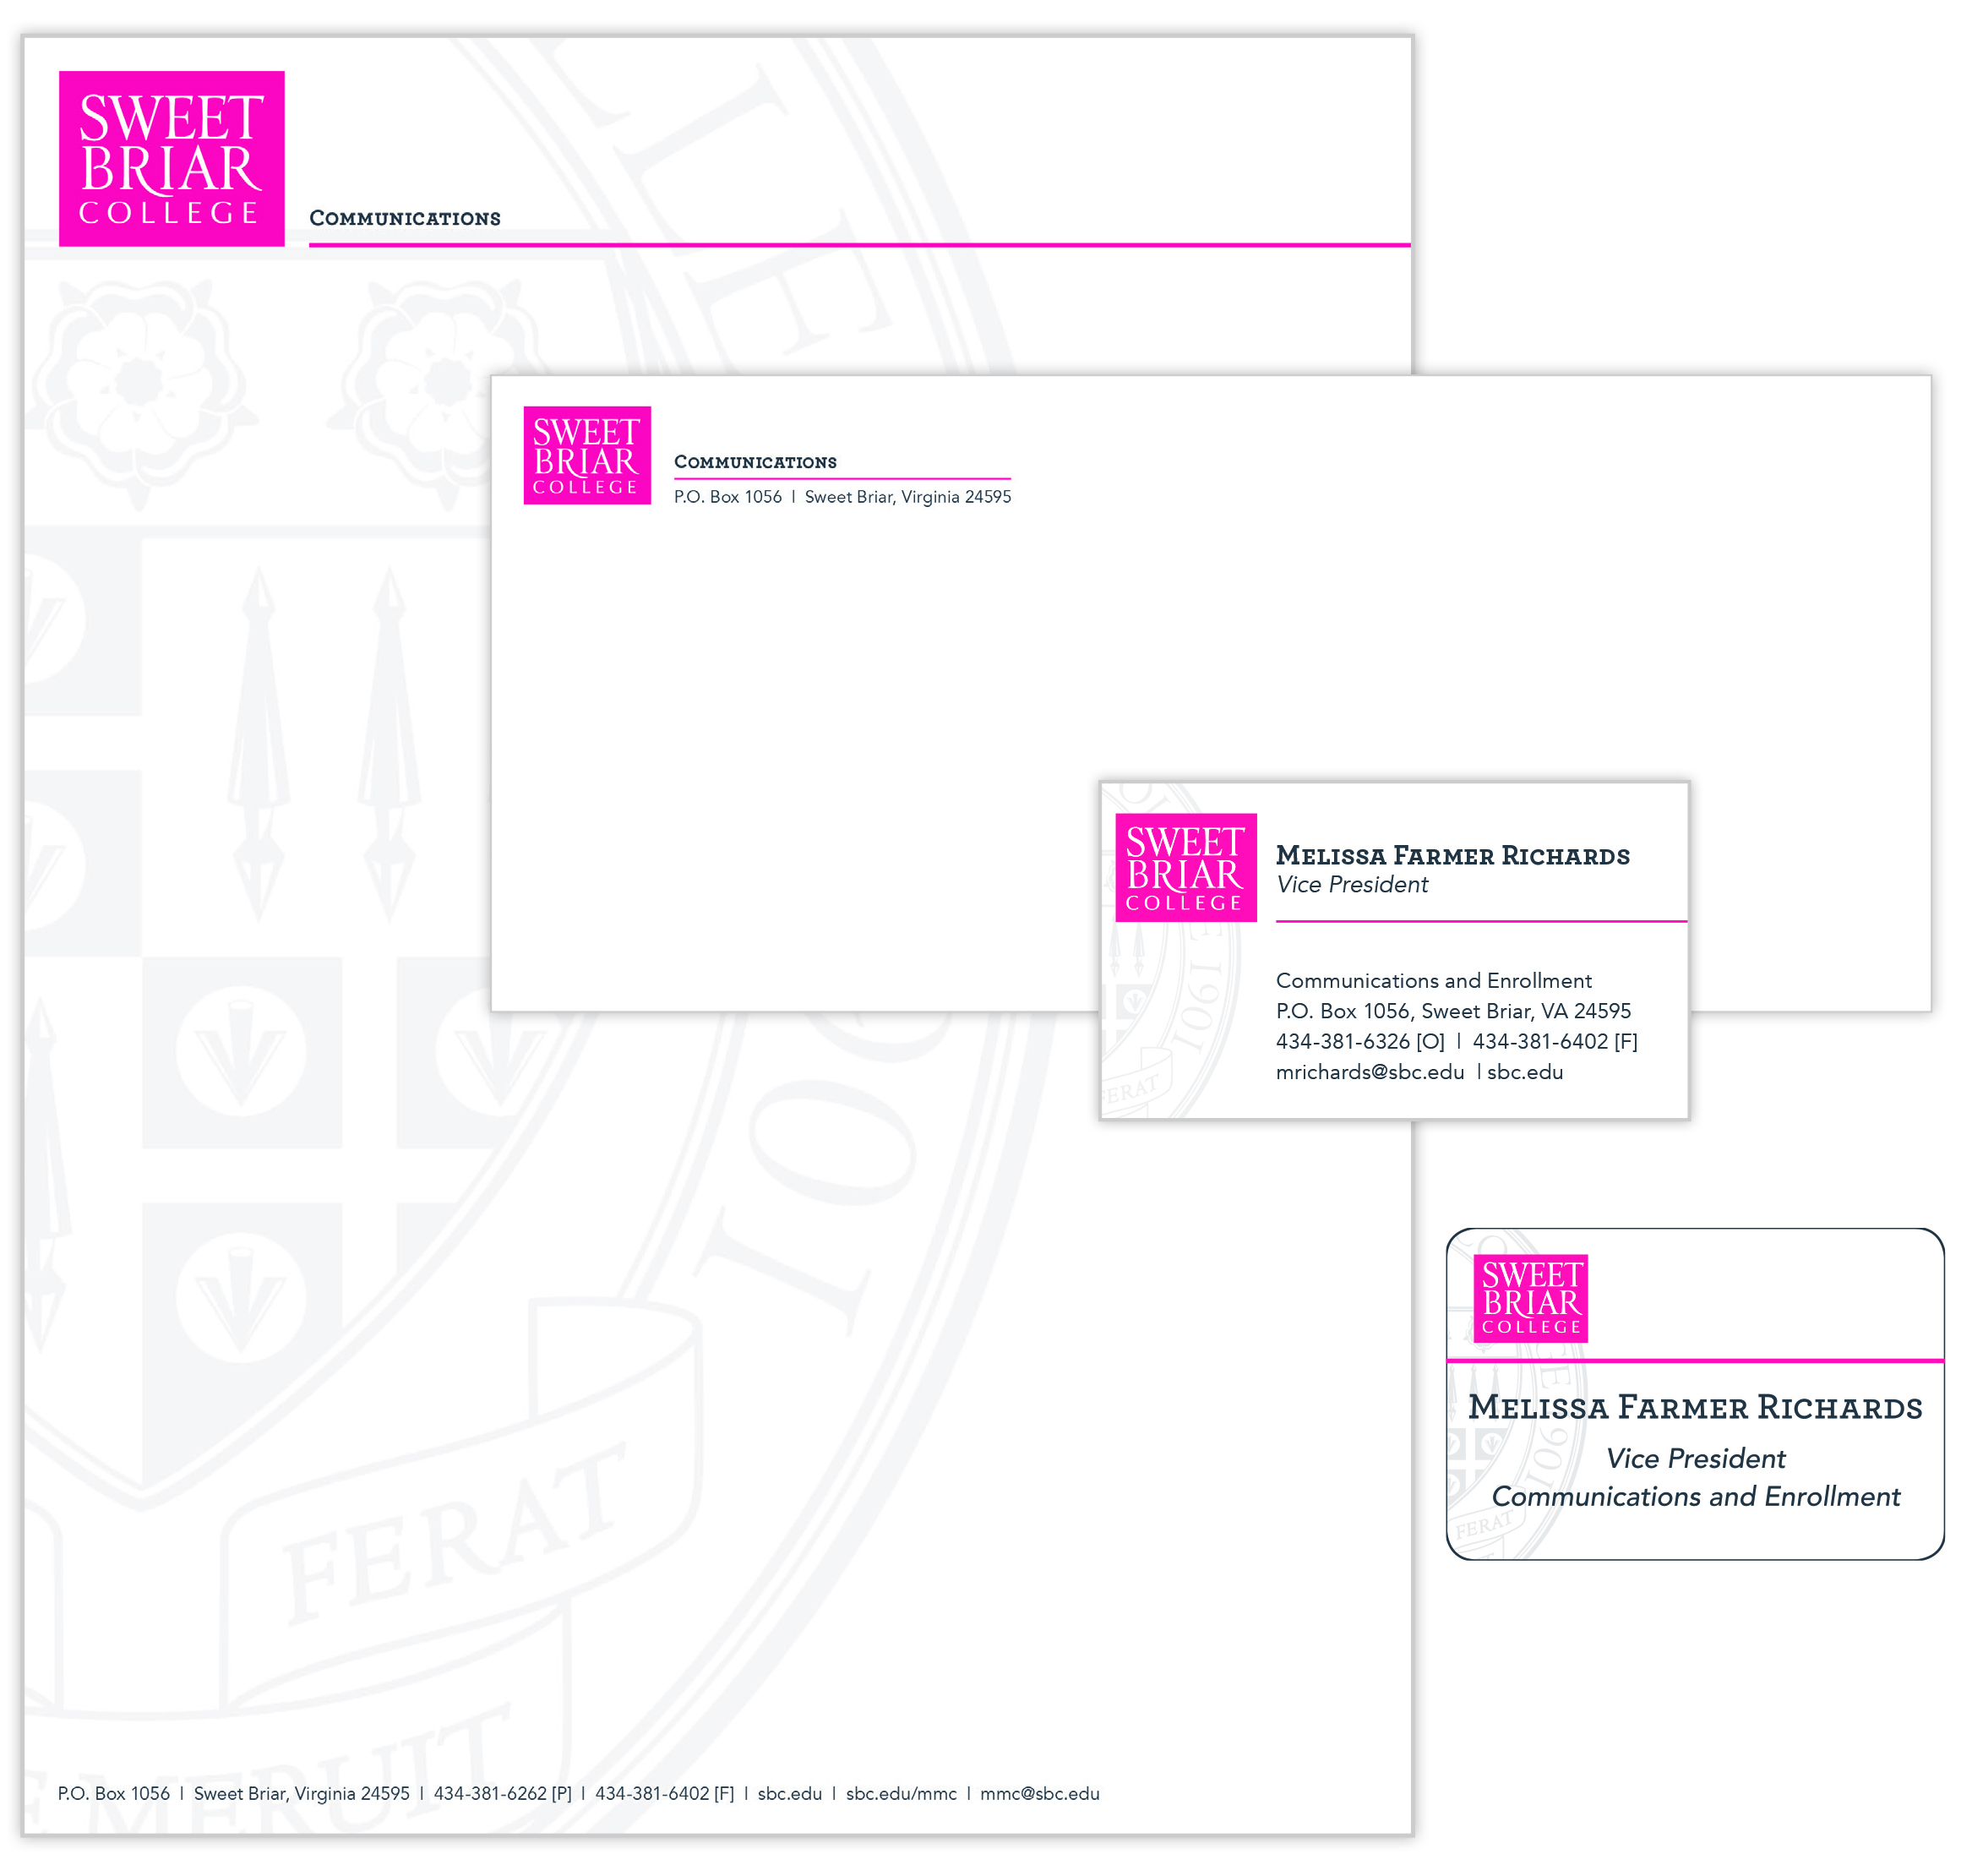
Stationery items, business cards and name badges
………………………………………………………………………….
To order business cards and name badges, go to sbc.edu/mmc/stationery-business-cards-and-name-badges. To order stationery, please contact Debbie Jordan, djordan@sbc.edu or Ext. 6262.
Brand
IDENTITY
August 2017

Slide 26


